Slide 1
Use to abuse: substance use disorders (SUDs) and the brain
Lecture 2

Slide 2
Key Concepts
Textbook makes two points worth (re-)highlighting as we begin:
1) Different types of drug-taking behavior apply to all drugs
For less familiar drugs, we have a tendency to assume that if a person uses it at all, they are “addicted”.
2) However, most people who use any drug are not addicted
Why do some people get addicted, but not others?

Slide 3
“Drug Use”
“Drug Addiction”
Notes:
National Survey on Drug Use and Health - What do we notice??

Slide 4
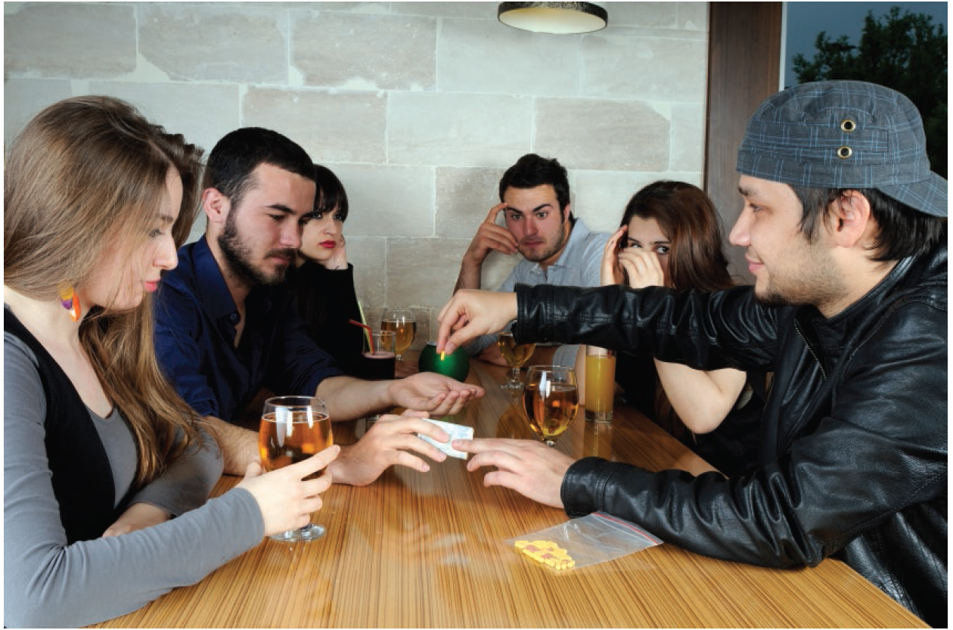
Drug Use to abuse
Gateway - One of the first drugs used by a typical drug user.
Alcohol and tobacco (followed by marijuana) are sometimes considered gateway drugs.
Gateway substances are perhaps best thought of as early indicators of a general pattern of behavior resulting from a variety of psychosocial risk factors.

Slide 5
Marijuana
Notes:
Looks pretty much identical to the marijuana graph. Why?

Slide 6
Is marijuana a gateway drug?
There is a positive correlation between marijuana use and use of “harder” drugs
(heroin, cocaine, etc)
Marijuana Use
Harder Drug Use
Notes:
2 major explanations in the field: “causal” Gateway and Common Liability

Slide 7
Gateway Hypothesis
Where did it come from?
A correlational study from the 1970s….
Gateway Hypothesis describes a sequence of drug use:
1) alcohol & tobacco
2) marijuana
3) harder illicit drugs

Slide 8
Why? (Explanations of Gateway Sequence)
Marijuana Use
Harder Drug Use
Gateway Explanation
1) Causal (often neurobiological) explanation
“Marijuana changes the brain in ways that make use of harder drugs more likely.”
But the data we have is purely correlational.
Design an experiment to describe what would have to be done to say that there’s causation?
If interested - some thoughts from your textbook author on the gateway hypothesis: https://www.youtube.com/watch?v=SKiMeiU33jk&t=466s&ab_channel=WIRED

Slide 9
Common liability Explanation
Common Liability Explanation
Alternative to neurobiological ‘explanation’ of Gateway Sequence
2) A third factor causes both early marijuana use and later “hard drug” use
But what is that factor?
Textbook talks about a “general deviance-prone pattern of behavior”
Third Factor
Marijuana Use
Harder Drug Use

Slide 10
Addiction

Slide 11
Misuse - Two Categories of Problems
Problems directly related to taking a drug.
Risk of developing drug dependence.
Risk of overdose.
Problems related to continued use of certain drugs
Arrests, fines, and jailing (deviant acts)

Slide 12
Addiction
“Addiction” is not an official diagnosis
But “addiction” is widely used both in scientific research and by the general public, so we will use it.
Substance Use Disorder (SUD) (opioid use disorder, stimulant use disorder, alcohol use disorder, etc.) is the official diagnosis as of 2013.
Previously, a person suffering from addiction would be diagnosed with “substance dependence”.

Slide 13



Substance use disorder –
Dependence is very hard to define
When does a drug user go from “recreational user” to someone who has developed a dependence?
Does it matter:
What drug is ingested?
What is the frequency of the drug intake?
How much drug is ingested?

Slide 14
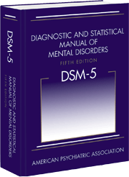
DSM-5 – substance use disorder
Psychiatric diagnosis of substance use disorders:
Diagnostic and Statistical Manual of Mental Disorders, fifth edition (DSM-5).
Developed by the American Psychiatric Association.
Provides definitions of substance use disorder.
Focuses on complex behavioral definitions.

Slide 15
DSM-5 “Substance Use Disorder” Diagnostic Criteria
A pattern of drug use leading to clinically significant impairment or distress, as manifested by at least two of the following 11 criteria, occurring within a 12-month period:
1. The drug is often taken in larger amounts or over a longer period than was intended.
2. There is a persistent desire or unsuccessful efforts to cut down or control drug use.
A great deal of time is spent in activities necessary to obtain the drug, use the drug,
or recover from its effects.
4. Craving, or a strong desire or urge to use the drug.
5. Recurrent drug use resulting in a failure to fulfill major role obligations at work, school, or home.
Continued drug use despite having persistent or recurrent social or interpersonal problems caused or exacerbated by the effects of the drug.

Slide 16
7. Important social, occupational, or recreational activities are given up or reduced because of drug use.
8. Recurrent drug use in situations in which it is physically hazardous.
9. Drug use is continued despite knowledge of having a persistent or recurrent physical or psychological problem that is likely to have been caused or exacerbated by the drug.
10. Tolerance, as defined by either of the following:
--A need for markedly increased amounts of the drug to achieve intoxication or desired effect.
--A markedly diminished effect with continued use of the same amount of the drug.
11. Withdrawal, as manifested by either of the following:
--The characteristic withdrawal syndrome for the drug.
--The drug (or a closely related substance) is taken to relieve or avoid withdrawal symptoms.

Slide 17
DSM-5 1
Diagnosis is complex:
Nine of the possible symptoms are behavioral.
Two of the possible symptoms are physiological.
Physiological symptoms do not need to be present to receive diagnosis.
Severity:
One symptom could indicate an individual is at risk.
Two or three criteria point to a mild substance use disorder.
Four or five symptoms show someone has a moderate substance use disorder.
Six or more criteria indicate “a severe substance use disorder, which signals an addiction to that substance.”

Slide 18
Substance Dependence Processes defined by researchers
Three basic processes that (may) occur with repeated drug use:
1) Tolerance.
2) Physical dependence.
3) Psychological dependence.
Notes:
That’s what the psychiatrists say, what about researchers?

Slide 19

1) Tolerance
A phenomenon in which repeated exposure to the same dose of a drug results in a lesser effect.
It can be overcome by increasing the dose of the drug.
Our body develops ways to compensate for the chemical imbalance caused by a drug.
Results in needing more of the drug for the same effect
Tolerance typically precedes physical dependence.

Slide 20
2) Physical Dependence
Physical dependence means the body has adapted to the presence of the drug.
Physical dependence is defined by the occurrence of a withdrawal syndrome.
If drug use is stopped suddenly, drug withdrawal symptoms occur, ranging from mild to severe.
Discontinuation of drug produces set of (usually unpleasant) symptoms
https://www.youtube.com/watch?v=NaMgdlUcsko (tw)

Slide 21
What explains tolerance and withdrawal?
Opponent-Process Theory
Essentially the concept of homeostasis - the tendency toward a relatively stable equilibrium between interdependent elements, especially as maintained by physiological processes.

Slide 22
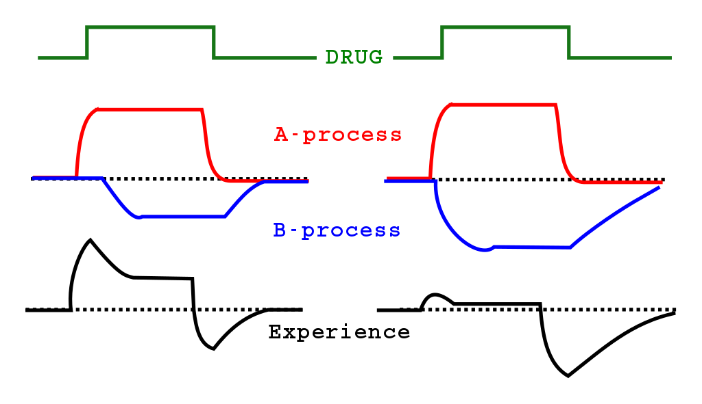
Early in drug use……
A- proc
A: process is the effect of the drug
Creates an imbalance, disturbing homeostasis
B: process is the compensating
(“opposing”) response of brain/body, attempting to restore homeostasis
Actual experience of the drug is : A-process minus the B-process

Slide 23
Early in drug use:
After chronic drug use:
Tolerance
Withdrawal
After chronic use, the body’s compensating response gets stronger – this causes tolerance.
If drug is suddenly withdrawn, body’s compensating response continues….but there is no drug to oppose.
Now there is an imbalance in the opposite direction
Experiencing this compensating (“opposing”) response without drug is what causes withdrawal symptoms
Notes:
There is a peak response to any emotional stimulus which usually occurs rapidly, usually out of shock, but lasts only as long as the stimulus is present.

Slide 24

What about drugs with no clear withdrawal symptoms? Changing Views of Addiction
Old mantra – ‘True’ addiction involves physical dependence.
More current model - Positive reinforcement model
Drugs can reinforce behavior without physical dependence.
Sometimes helpful to think of “non-drugs” to see the difference…

Slide 25
3) Psychological (behavioural) Dependence
Psychological dependence, based on reinforcement, is increasingly viewed as the driving force behind repeated drug use.
Behavioral psychology contextualizes psychological dependence.
Often indicated by/defined in terms of observable behavior:
Frequency of using a drug or by the amount of time or effort spent in drug-seeking behavior.
Reports of craving the drug or its effects.

Slide 26
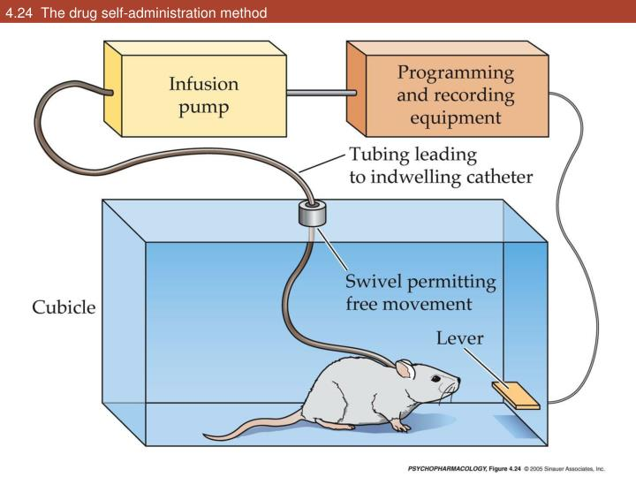
Research evidence for Psychological Dependence
Administration of certain drugs can reinforce the behaviors that led to the drug’s administration.
Studied in the lab with “drug self-administration” method.
Laboratory animals press levers when the only consequence of lever pressing is a small intravenous injection of heroin, cocaine, or another drug.
Psychological dependence with positive reinforcement:
If rat presses a lever and gets food, the rat is more likely to keep pressing the lever
The food strengthened (“reinforced”) the lever press behavior
positive reinforcement because the food was added (positive) after the lever press
Notes:
https://www.youtube.com/watch?v=gFSQFtVb87E –rat park video

Slide 27
All drugs self-administered by animals have addiction potential in humans.
Cocaine
Heroin
Morphine
Codeine
Oxycodone
Amphetamine
Methamphetamine
Ecstasy (MDMA)
Alcohol
Barbiturates
Benzodiazepines
Nicotine
Caffeine
THC
PCP
Drugs not self-administered by animals, but used by humans:
LSD
Psilocybin
Mescaline

Slide 28
What causes addiction (substance use disorder)?
Nobody can say for sure
We do know about correlates of addiction.
1) personality characteristics (e.g., impulsivity)
2) other disorders (e.g., depression)
3) genetic/brain characteristics (e.g., number of dopamine receptors)
Notes:
But, as always with correlations…we don’t know if X caused Y, or Y caused X, or a third factor caused both X and Y

Slide 29
Is there an ‘Addictive’ Personality?
Impulsivity (tendency to act quickly without much regard to long-term consequences) and “sensation-seeking” personality traits have been associated with greater risk for abuse of stimulants
Sensation-seeking scale measures a person’s preference for variety, risk, and various physical sensations.
Alcohol use disorder often exists within dysfunctional families and relationships.
Evidence suggests these may be risk factors that may play a role in dependence.
There is no way to know if a drug or drug use changes an individual’s personality.

Slide 30
What are the most addictive drugs?
Table 2.2: Addiction Potential of Alcohol, Nicotine, Cocaine, and Marijuana
Substance | After 1 Year of Use | After 10 Years of Use | Lifetime Estimate
Alcohol | 2.0% | 11.0% | 22.7%
Nicotine | 2.0% | 15.6% | 67.5%
Cocaine | 7.1% | 14.8% | 20.9%
Marijuana | 2.0% | 5.9% | 8.9%
Notes:
James Anthony & Fernando Wagner asked two questions:
1) did you ever use the drug?
2) did you ever meet DSM criteria for dependence?

Slide 31
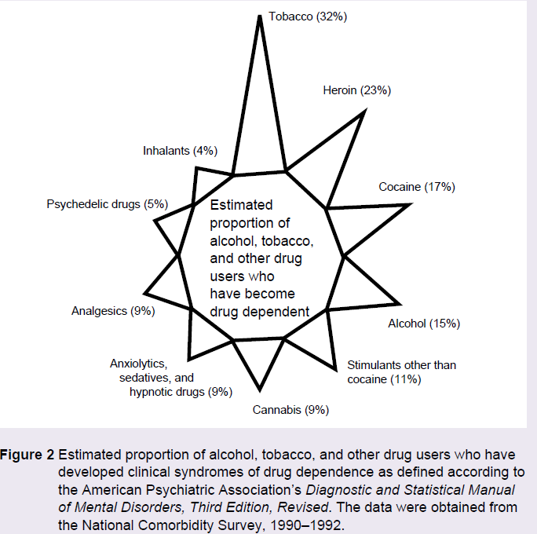
Is Addiction Caused by the Substance?
Some drugs are more likely than others to result in dependence.
Heroin and cocaine are both likely to lead to compulsive use.
Some substances are more “addictive” than others.
However, many other factors influence dependence, and thus, the substance itself cannot be seen as the entire cause of the problem.
Percentages in fig pertain to people ages 15-24

Slide 32
What causes addiction (substance use disorder)?
Although the drug taken is a factor, nobody can say for sure
We do know about correlates of addiction, though.
1) personality characteristics (e.g., impulsivity)
2) other disorders (e.g., depression)
3) genetic/brain characteristics (e.g., number of dopamine receptors)

Slide 33
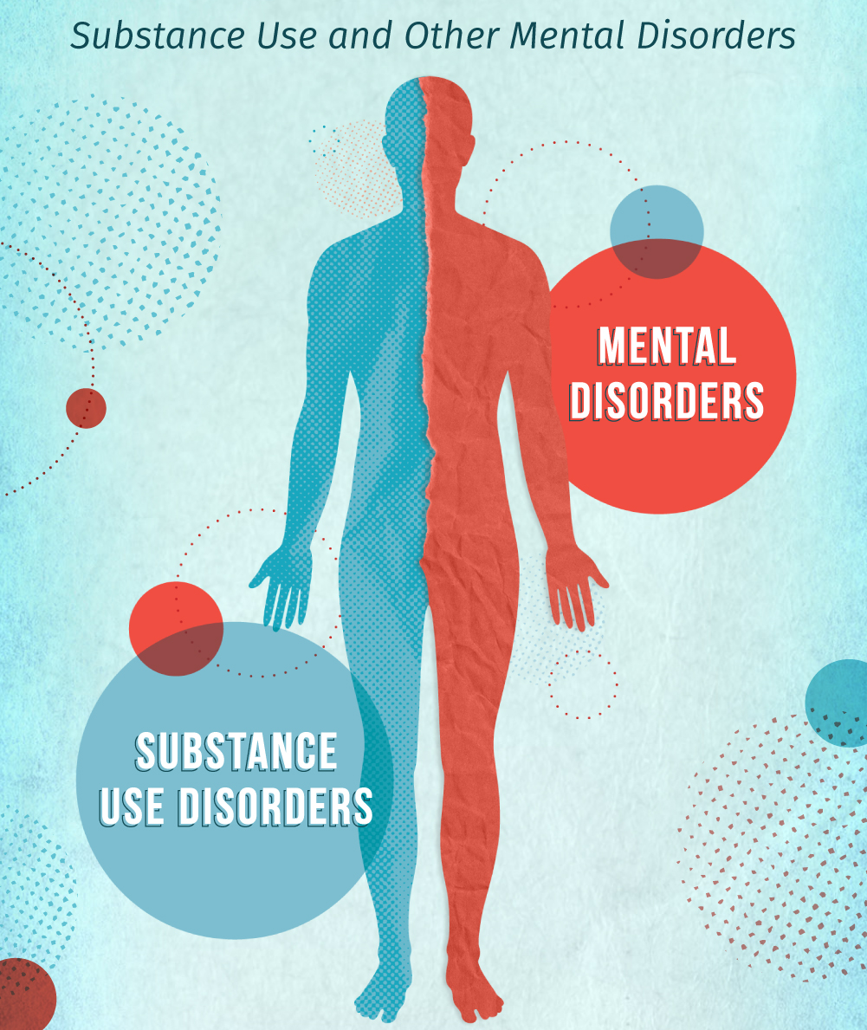
SUDs and COMORBIDITY

Slide 34
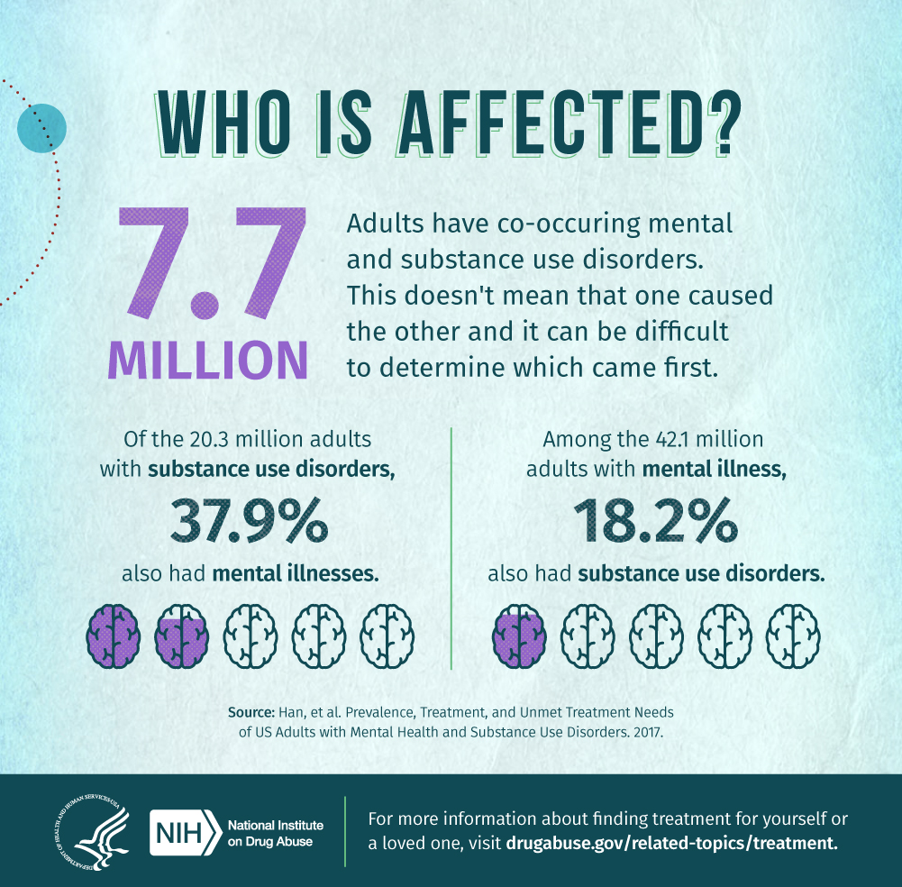
Comorbidity and substance use
Comorbidity: having two disorders at the same time
Very high rates of comorbidity between substance use disorder and many other psychological disorders.
Notes:
Having one disorder can be a risk factor for another…the interactions of the two can worsen both

Slide 35
Comorbidity and substance use (multiple SUDs)
30% of people with Illicit Drug Use Disorder also had Alcohol Use Disorder vs. 6% of general population 12+

Slide 36
Comorbidity and substance use (Depression)
MDE is a risk factor for using drugs, alcohol, and cigarettes, about twice as likely to use

Slide 37
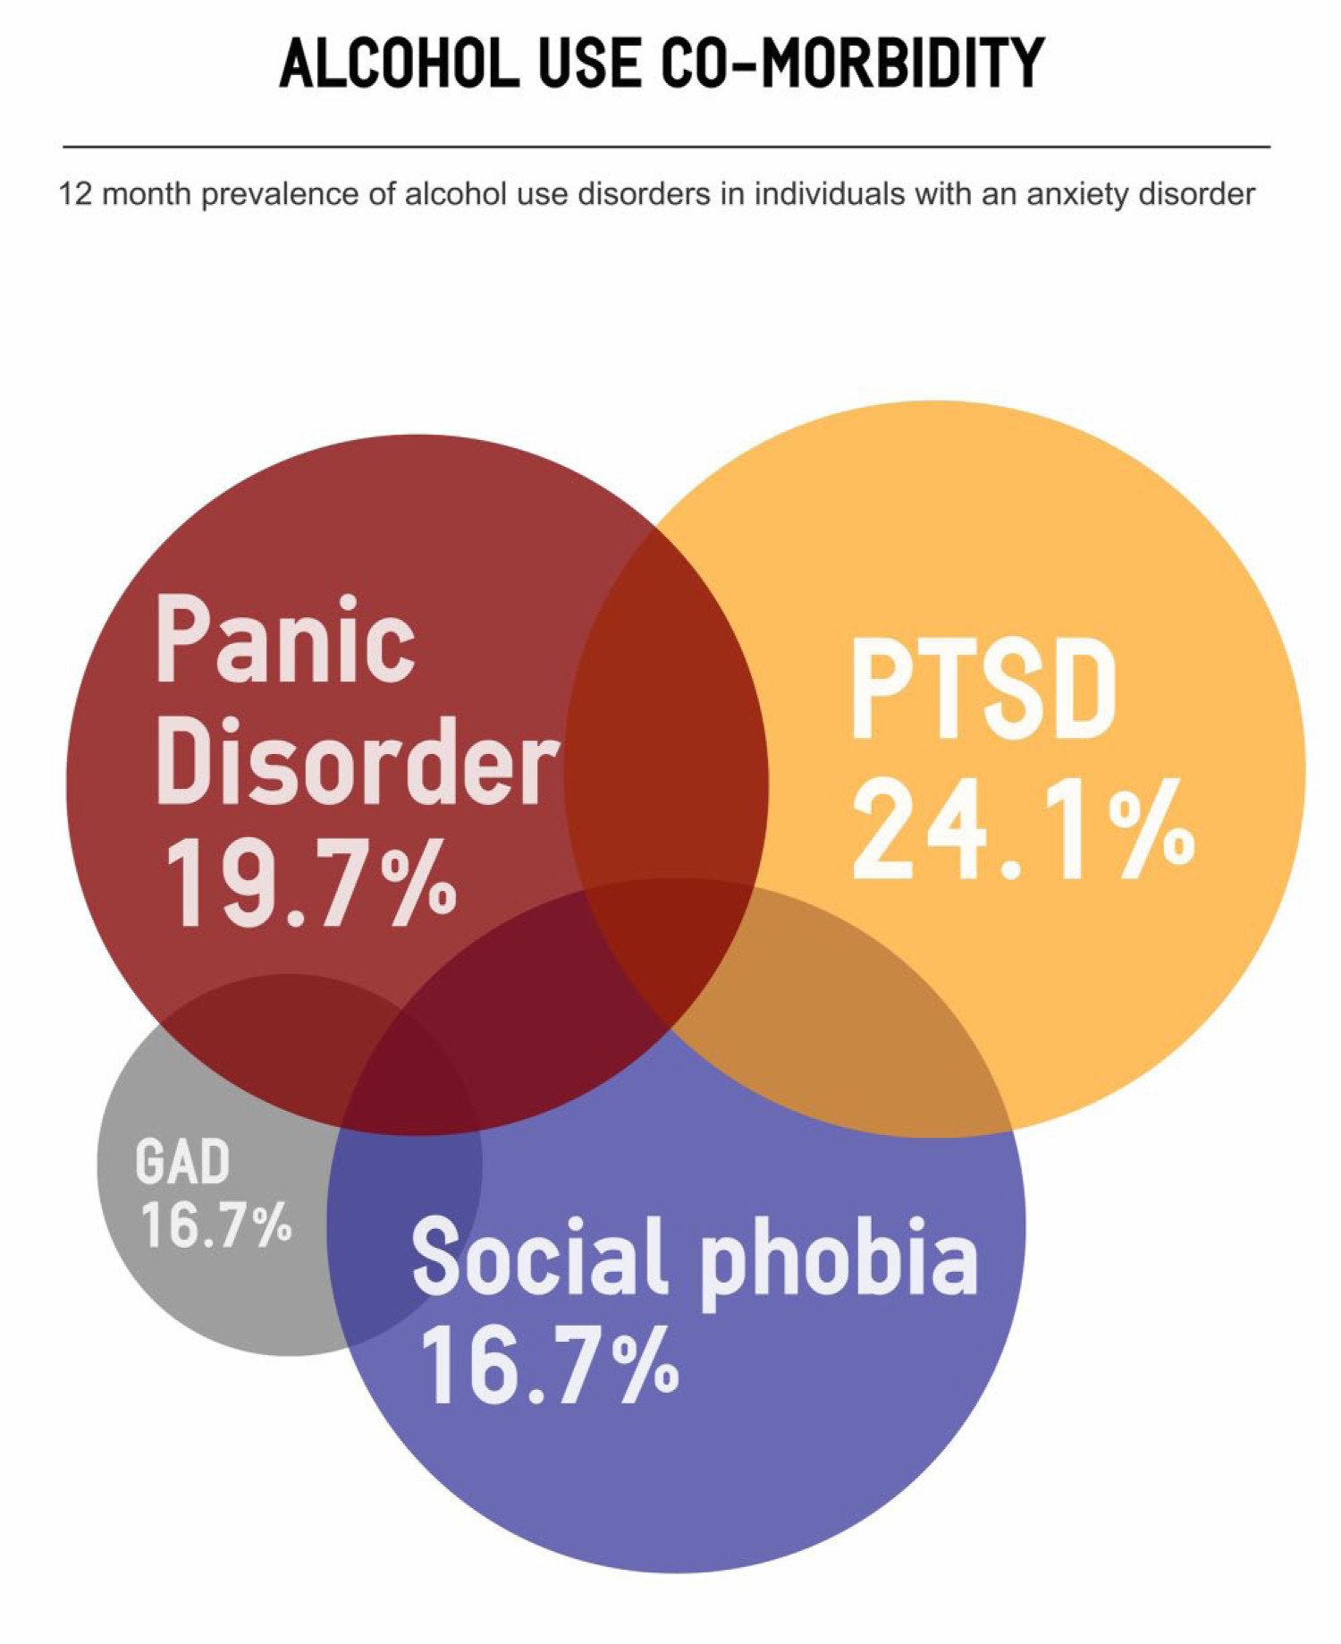
Comorbidity and substance use (Anxiety disorders)
Research has shown that up to 50% of individuals receiving treatment for problematic alcohol use also met DSM criteria for one or more anxiety disorders.
?
Notes:
This percentage can be compared with the prevalence of current (within the past 12 months) anxiety disorders in the U.S. community, which is estimated to be 11%.
This is a terrible graphic but let’s talk about it.

Slide 38
What causes addiction (substance use disorder)?
Nobody can say for sure
We do know about correlates of addiction, though.
1) personality characteristics (e.g., impulsivity)
2) other disorders (e.g., depression)
3) genetic/brain characteristics (e.g., number of dopamine receptors)

Slide 39
Is addiction a brain disease?
break

Slide 40
Theories (explanations) of Addiction
Older views:
1) moral failing, “vice”
Addiction is due to a “weak will”, or low morals
2) physical dependence
Being physically dependent (withdrawal) caused you to be addicted.
a person can be addicted without having withdrawal syndrome
a person can have withdrawal syndrome without being addicted
Newer views:
1) Brain Disease
2) Choice/Biopsychosocial

Slide 41
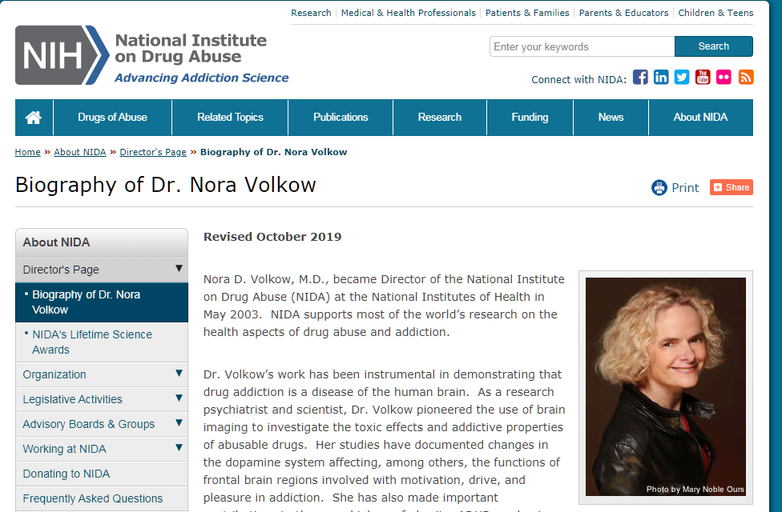
Is Addiction a Brain Disease?
Dr. Nora Volkow says “yes”
Director of the National Institute on Drug Abuse (NIDA), the NIH institute responsible for funding the majority of drug abuse science in the world (not just U.S.A!)
Addiction is a chronic, relapsing, disease.
http://www.youtube.com/watch?v=5f1ie_It8wM
Notes:
Clips: 0:00-2:20, 5:30-6:15, 12:45-13:20

Slide 42
Evidence for addiction as a brain disease?
Various kinds, but often cited is changes in the brains evidenced in people with addiction

Slide 43
Volkow’s theory – addiction as brain disease
Hypotheses:
1) Drug use causes brain changes
2) Those brain changes cause loss of self-control
3) Loss of self-control causes continued drug taking
Evidence: Numerous studies in both animals and humans have shown that there are genetic influences on drug use, effects, and dependence.
Data suggest that genetic factors play a role in developing dependence, but the specific genes and the biological mechanisms causing dependence are still being determined.

Slide 44
Hart’s view - addiction is not a brain disease
Not everybody agrees with brain disease theory.
Evidence: Substance use disorders do not have many of the characteristics of medical diseases.
There are no tests to reveal the underlying cause.
When the brain disease view began, it was thought it would destigmatize addiction.
Dr. Carl Hart argues that it does the opposite – and much worse.
https://www.youtube.com/watch?v=90MHZbXrmY0&ab_channel=BigThink
Notes:
It is better to think of “disease” as an analogy for substance use disorder.

Slide 45

alternative to Brain Disease : Choice
Choice/Biopsychosocial perspective - Addiction might be related to dysfunctions of biology, personality, social interactions, or a combination of these factors.
Instead, instances of drug-taking behavior are viewed as contingency-based choices
if choice to take drugs happens so often that it interferes with life, may result in substance use disorder
The choice view doesn’t say that people choose to have an addiction
Gene Heyman: https://www.youtube.com/watch?v=jh0ZAUxuQSo (0:24-6:20)

Slide 46
Choice/biopsychosocial paradigm
Evidence for choice view of addiction:
1) very high spontaneous remission (i.e., quitting without treatment) rate
Also called “natural recovery”
Don’t see this with other diseases
2) drug-taking behavior can be determined by consequences (costs/benefits), even in people with diagnosed SUDs
Reasons given for quitting: “what will my family think?”, “will I lose my job?”
Contingency Management Lab Studies:

Slide 47
Evidence for: Choice/biopsychosocial paradigm
Cocaine vs. money choice in humans
Reprint from Higgins, Heil, & Lussier, 1994
Notes:
Long Carl Hart Video if interested: https://www.youtube.com/watch?v=AzupwJDje_4

Slide 48
Evidence for: Choice/biopsychosocial paradigm
“Behavioral”= Contingency Management

Slide 51
Notes:
Recency bias….

Slide 52
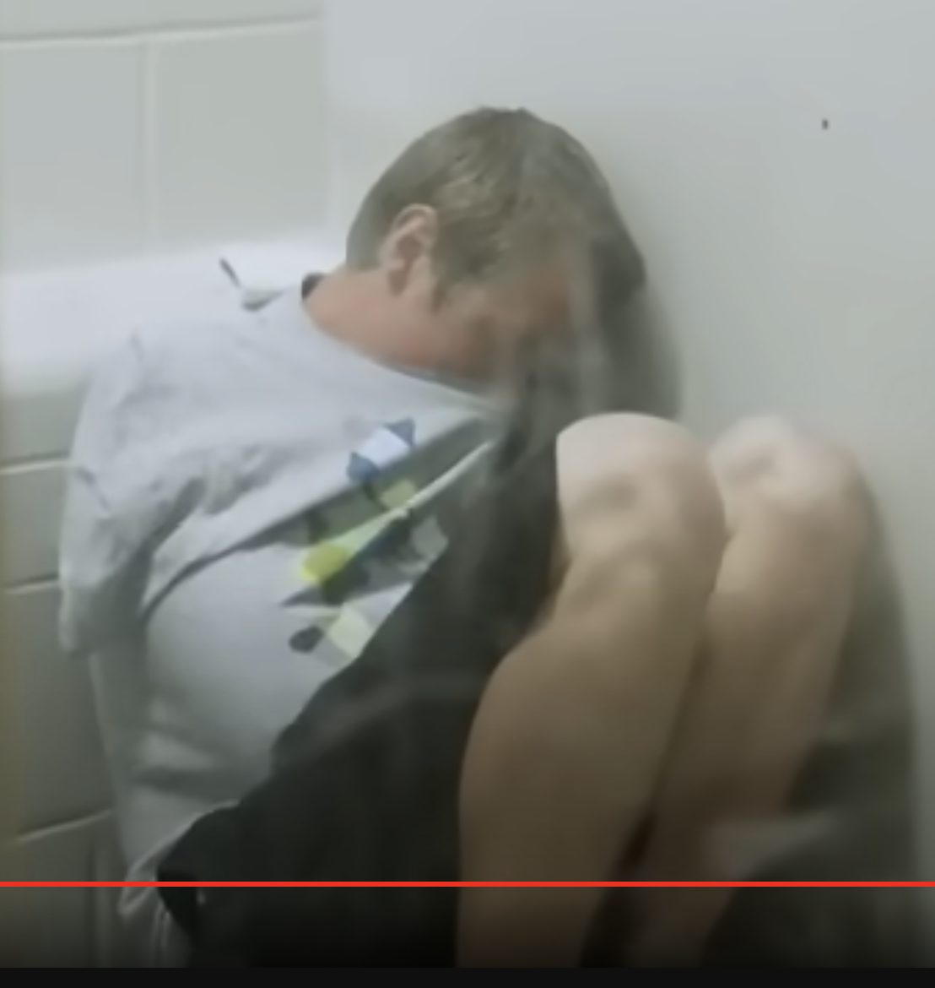
Is addiction a brain disease?
Notes:
Let’s discuss this…
Can you think of other evidence one way or another?

Slide 53
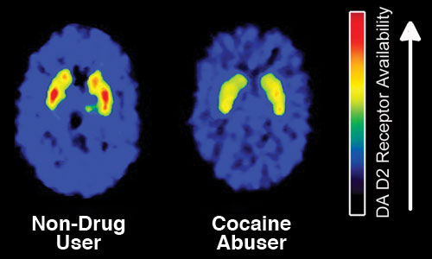
Drugs inarguably alter the brain.
Even if it is NOT a brain “disease”, the brain and drug-related neurochemistry is clearly involved in many ways…

Slide 54
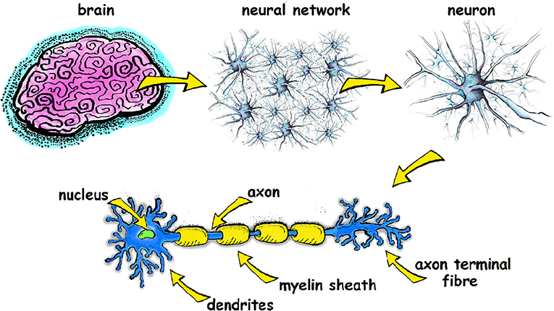
Outline : neuroanatomy
Brain Nucleus/

Slide 55
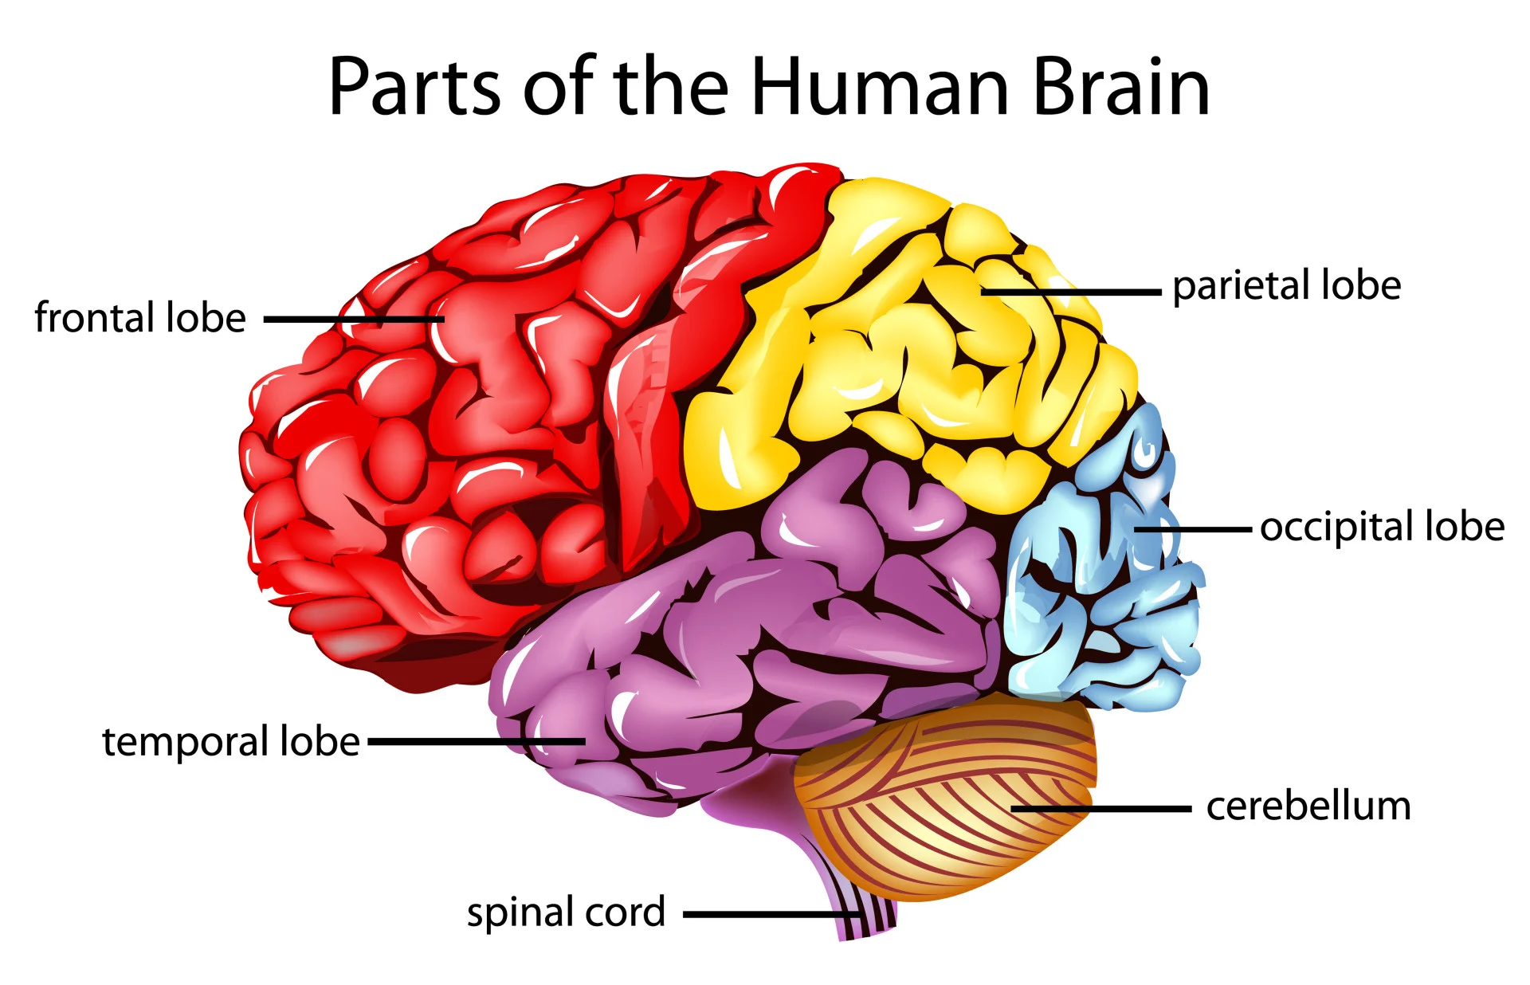
anatomical Lobes of the human brain
Notes:
The highly convoluted cortex of the human brain provides more surface area in a relatively small space
Gyri (singular: gyrus) are the folds or bumps in the brain and sulci (singular: sulcus) are the indentations or grooves

Slide 56
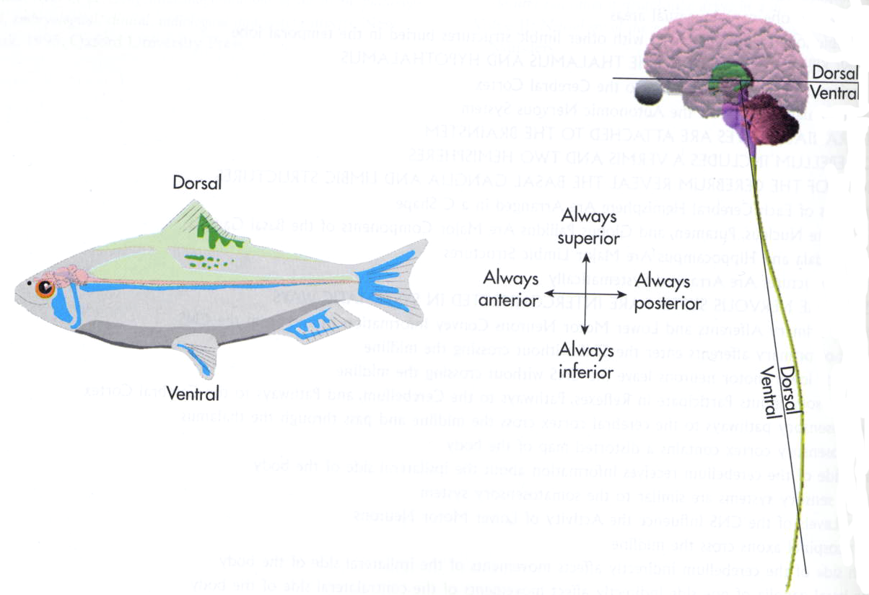
Anatomical terms of direction
rostral
caudal
Notes:
differ between comparative and human anatomy

Slide 57
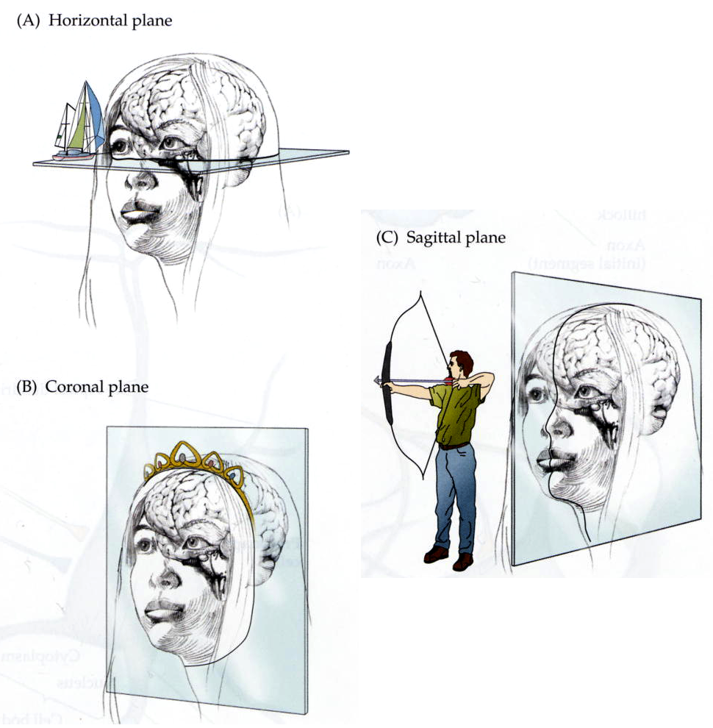
Common planes of brain sections: A) horizontal B) coronal C) sagittal
Notes:
(frontal/coronal)

Slide 58
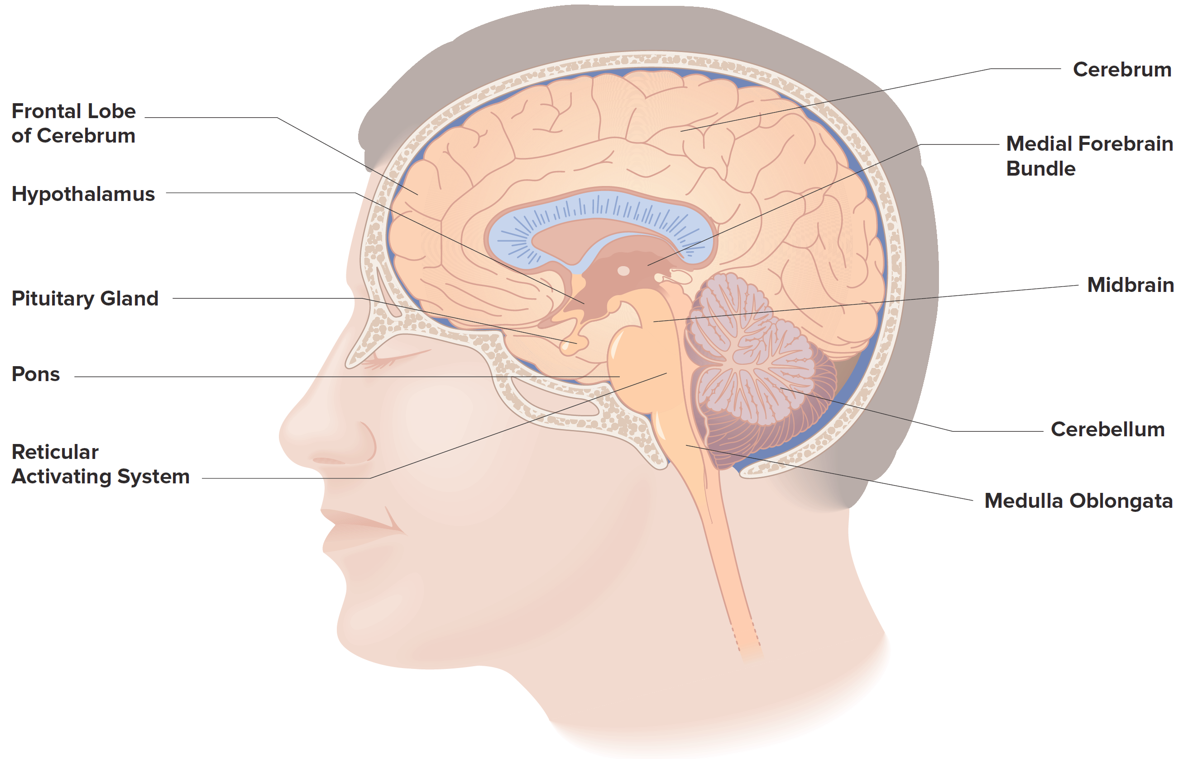
the human Brain: Major Structures/Regions
Corpus Callosum
(Cortex)
(Prefrontal Cortex)
Thalamus
Pineal Gland
Figure 4.4

Slide 59
neuroanatomy
Brain Nucleus/

Slide 60
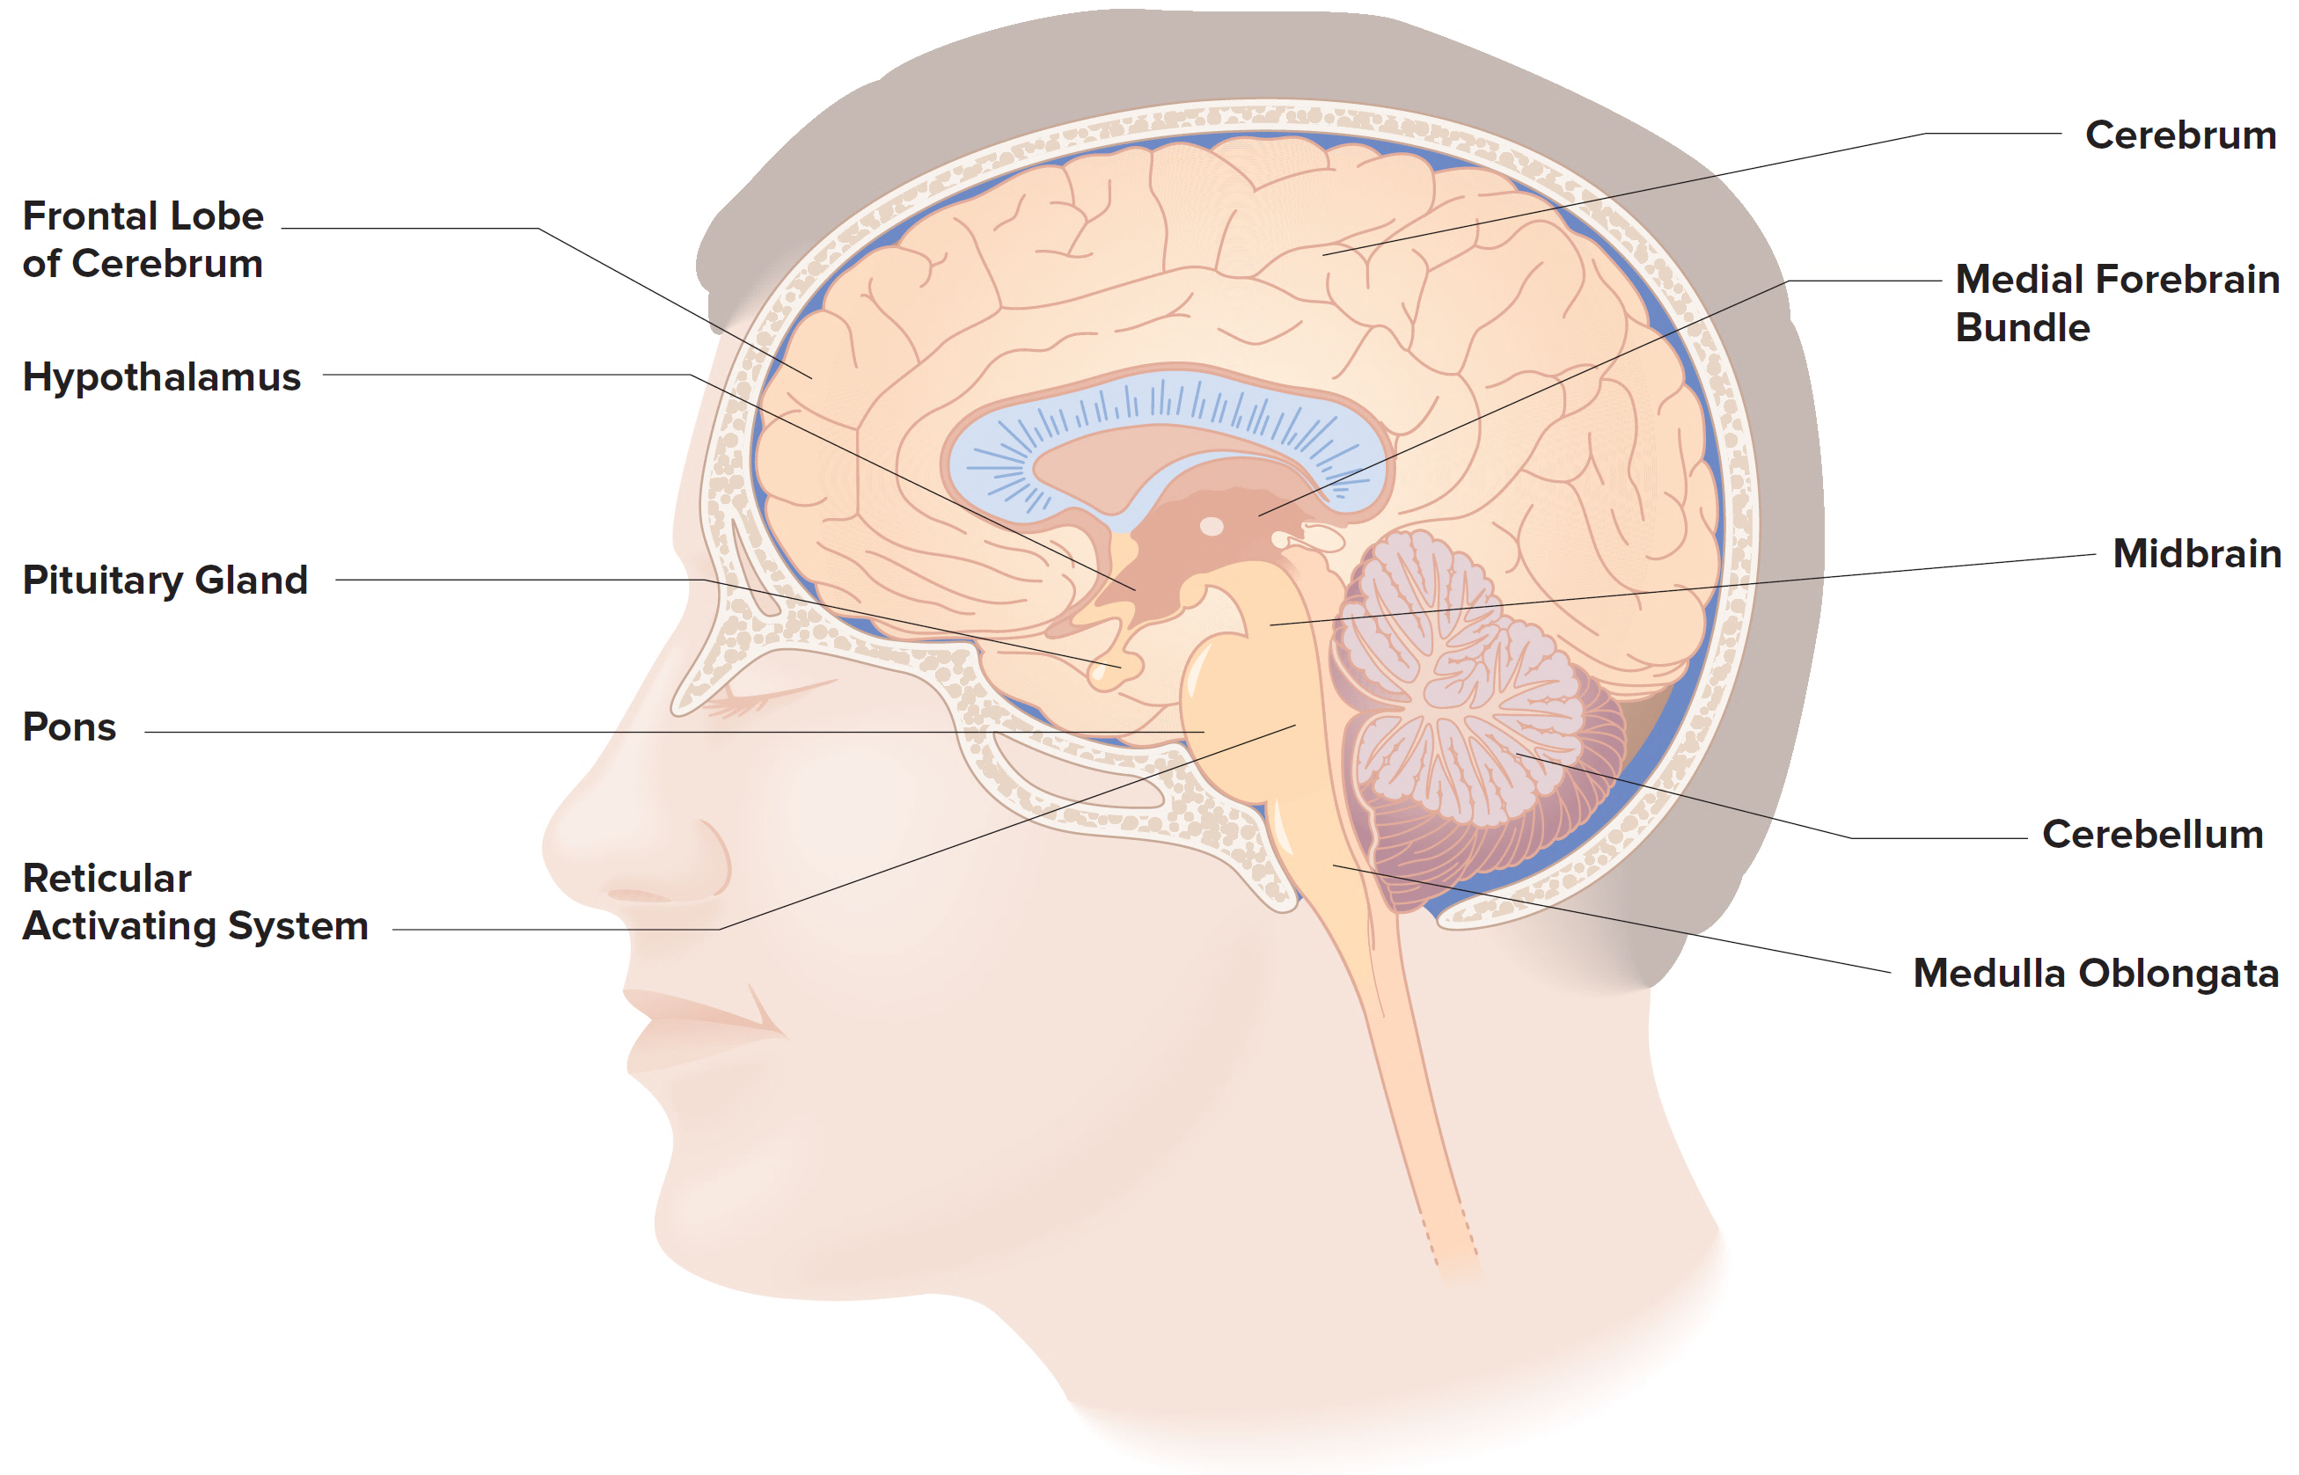
the Brain: critical Nuclei for drugs effects
In neuroanatomy, a nucleus (pl. : nuclei) is a cluster of neurons, located deep within the cerebral hemispheres and brainstem.
The neurons within one nucleus usually have roughly similar connections and functions.

Slide 61
the Brain: Key Nuclei
Striatum
Nucleus Accumbens
Substantia Nigra
VTA - Ventral Tegmental Area
Locus Coeruleus
Dorsal Raphe
Figure 4.4 (ignore any black lines without →)

Slide 62
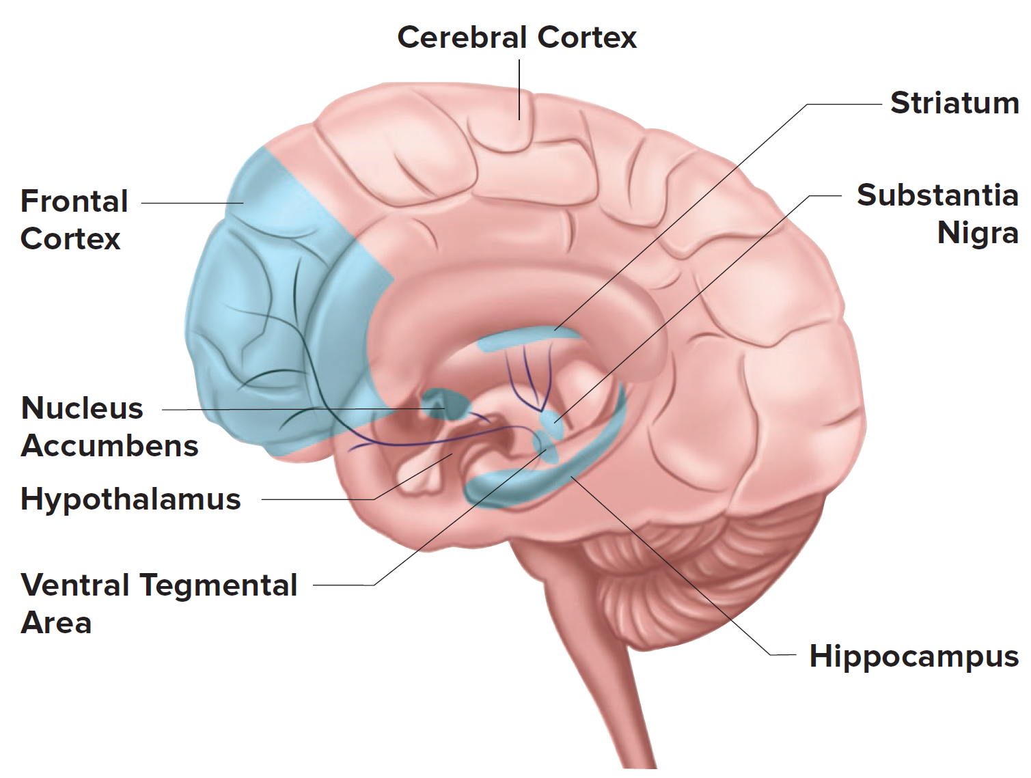
FYI – your book shows some of these with this Figure 4.3:

Slide 63
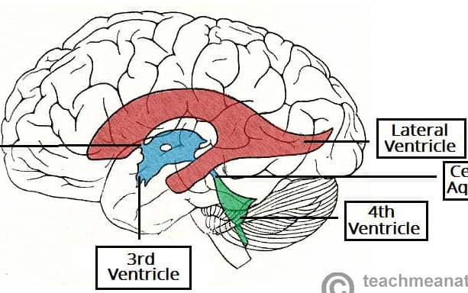
ventricles
Def: a hollow part or cavity in an organ.
wrt to the Brain:
each of the four connected fluid-filled cavities in the center of the brain.
Notes:
“Lateral ventricles”, “3rd and “4th ventricles.
You don’t need to memorize location/names (that’s why I took them off!), but should know that the brain has ventricles, and roughly where.

Slide 64
Research on the human brain and behaviour
How do we visualize the human brain and changes in neural activity?

Slide 65
Brain imaging tools
Structure
MRI
CT
Function
EEG
PET
fMRI

Slide 66
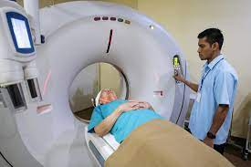
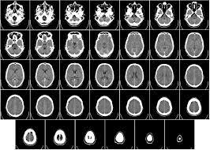
Brain Imaging Techniques: CT (computerized tomography)/CAT Scan
Technique that takes X-ray photos of the brain
Benefits.
Used primarily to assess brain damage
Fast and cheap
Limitation.
Uses radiation
Provides no information about brain functioning.
Notes:
Structural

Slide 67
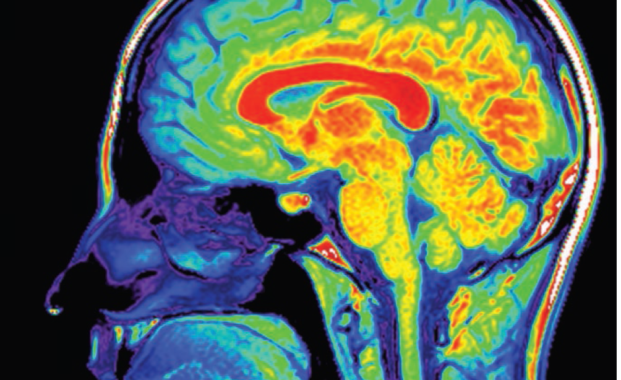
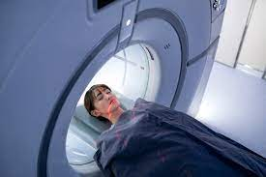
Brain Imaging Techniques: Magnetic Resonance Imaging, or MRI
Technique that uses powerful magnets to determine the amount of hydrogen atoms at different locations in the body.
Benefits.
Provides a high-resolution image of the brain’s anatomy.
Could detect cysts, tumors, bleeding, inflammation/infection
Is noninvasive, superior image to CT scan.
Limitation.
Provides no information about brain functioning.

Slide 68
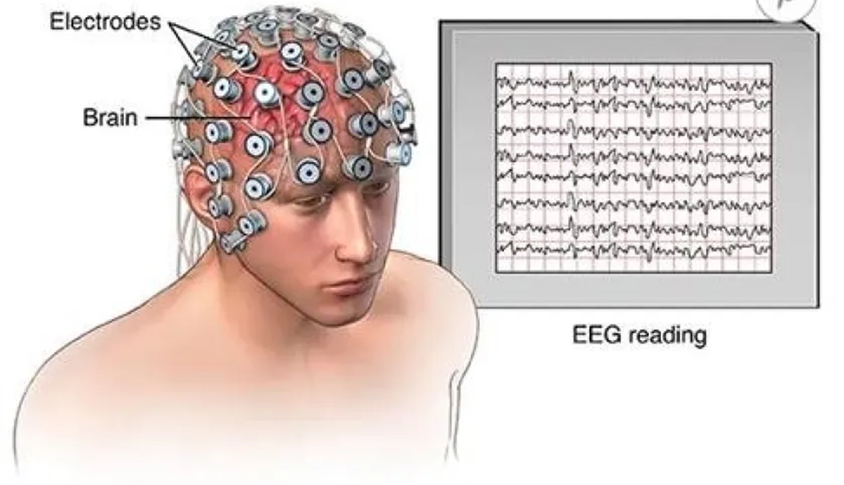
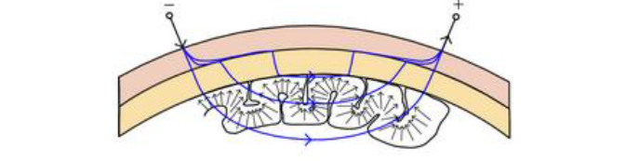
EEG (Electroencephalogram)
Uses electrodes to record electrical activity “brainwaves” within the brain.
Can confirm or rule out behavioral changes due to sleep disorders, seizures/epilepsy, head injury, encephalitis, stroke, etc

Slide 69
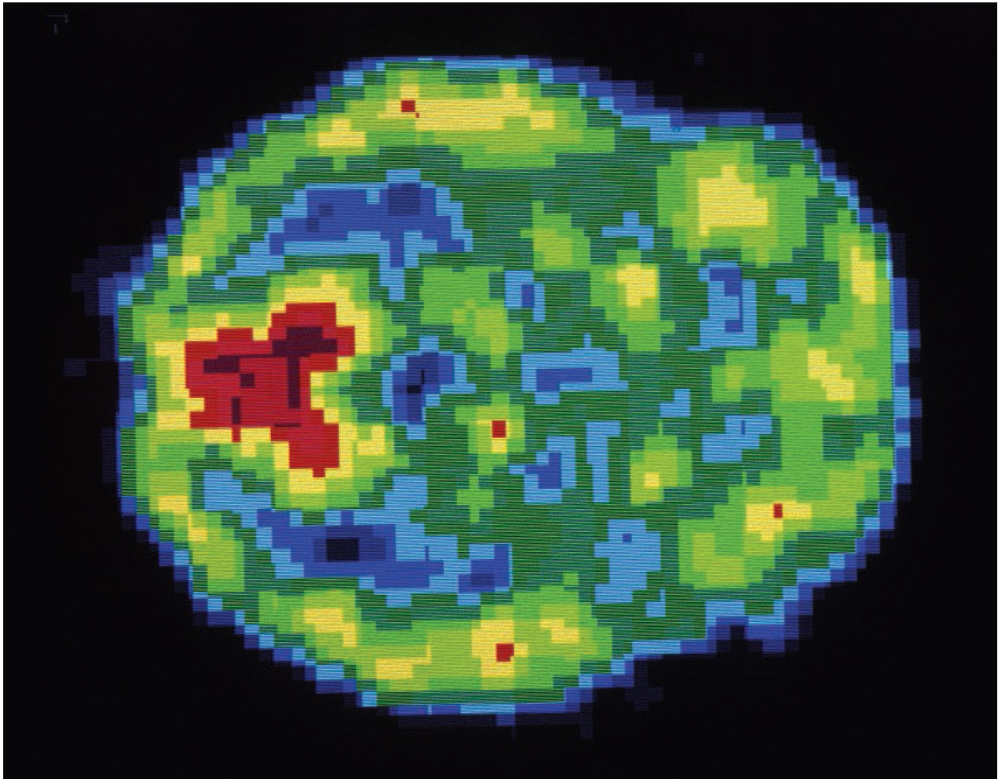
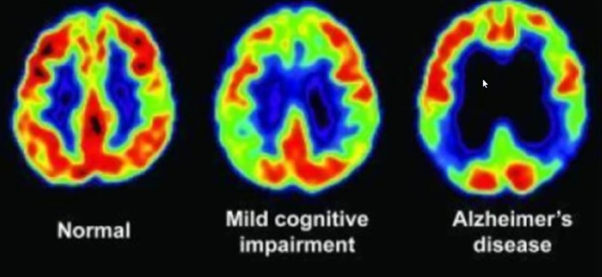
Brain Imaging Techniques: Positron Emission Tomography, or PET
A radioactively labeled chemical is injected into the bloodstream, and a computerized scanning device then maps out the relative amounts of the chemical in various brain regions.
Benefit.
Provides a direct measure of brain activity and an indirect measure of potential toxicity to specific neurons
Limitation.
Requires the injections of radioactive chemicals
No structural information
Warmer colors = more active

Slide 70
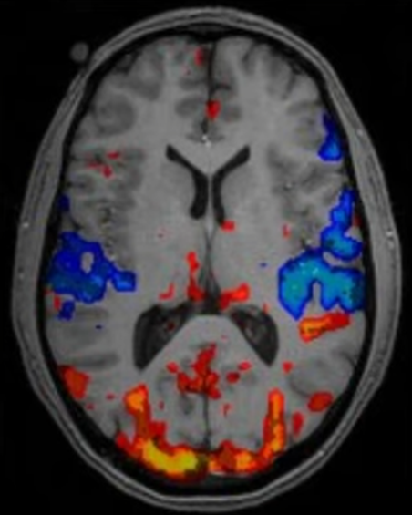
Brain Imaging Techniques: Functional Magnetic Resonance Imaging, or fMRI
Provides real-time information about changes in brain blood flow as an individual performs behavioral or cognitive tasks.
This is in the form of a “BOLD” signal (Blood-Oxygen-Dependent signal)
Benefits.
Gives real-time information about changes in brain blood flow.
Noninvasive, great pictures/resolution.
Functional technique but can still see structure at ‘CT level’
Limitation.
VERY expensive, also noisy
Does not provide any information about the anatomy of the brain.

